Slide 1
EPAM Cloud&DevOps Fundamentals Course 2022 Final Task
Mykhailo Pryshchepnyi
Dnipro
Feb 2023

Slide 2
About the Project
The project demonstrates the CI\CD process that is relevant and commonly used at the current time for software development and implementation.
It is important because it helps organizations rapidly produce and deliver high-quality software products and services, improving their overall efficiency, reliability, and security. The process automates the entire software development lifecycle, from code creation to deployment.
Additionally, it helps organizations to identify and resolve issues quickly, reducing downtime and increasing overall system stability.
The project uses next tools and services:
GIT and Github – version control system for storage and shared usage app versions and configuration files
AWS Cloud –Deployment of Prod and Dev environments
Jenkins – CI/CD processed automation
Terraform – automation of IaC environment deployment on AWS
Ansible – instances configuration management
Docker and Dockerhub – artifacts build and storage
Slack integration – for notification

Slide 3
Implementation
The project shows the CI/CD process of application continuous integration and deployment based on DevOps methodology and tools.
The process core is based on Jenkins – the central events handler.
When a GitHub event occurs Jenkins runs a specific job following the triggers and dependencies.
There are 4 jobs run on the project:
_CI_multibranch – triggered by Webhook from GitHub repo EPAM2022 with 2 branches (Main and Dev) if there are changes pull and run the job described in Jenkinsfile: run the agent -> install docker -> build a new artifact based on Dockerfile -> pull into DockerHub
_EPAM_ProdEnv_param – a manual job that builds Production Environment on AWS by using Terraform and Ansible (SG, ASG, ALB, etc.)
_Update_DockerDev – the job triggered by success finish _CI_multibranch/Dev job and updates the Development Environment by the latest version of the artifact.
_Update_DockerProd - the manual job that updates the Production Environment with the latest version of the artifact (can be also automated by a trigger from _CI_multibranch/Main job)

Slide 4
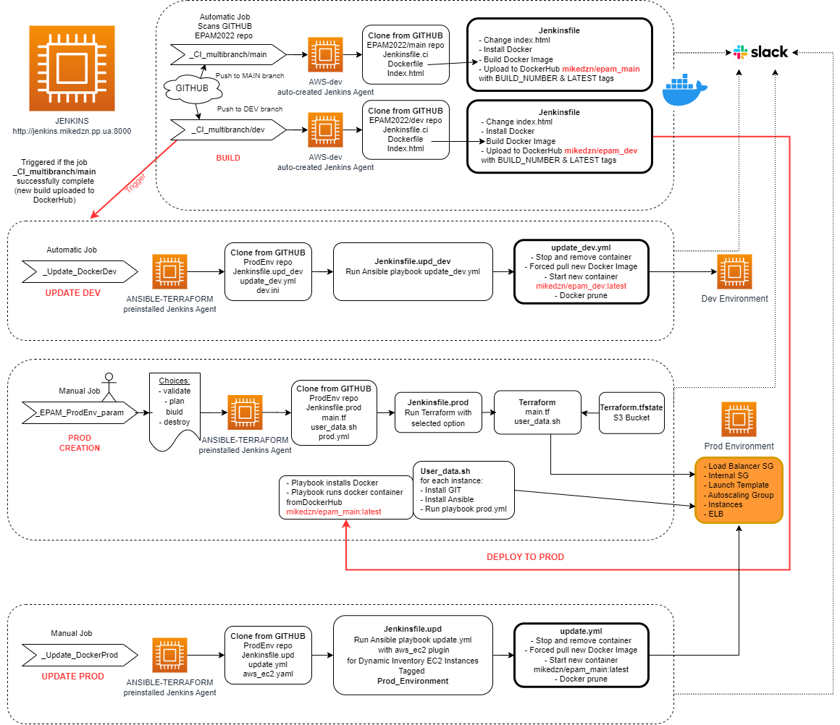
Design

Slide 5
DEMO / Conclusions
What is done:
Creation of AWS infrastructure using Jenkins, Terraform and Ansible
Continuous Integration job from Github push to upload artifact on Dockerhub
Auto-update Dev Env job if new build comes on Dockerhub
Manual update Prod Env job with Ansible Dynamic inventory with new build comes on Dockerhub
What can be improved:
Create additional VPC instead of Default
Add more complex project (DataBase, Java with Maven etc)
Monitoring

Slide 6
Questions

